Slide 1
Modular Programming(11-dars)
Davronbek Malikov

Slide 2

Bugun
Project 4 va savol javob
Model Performance Improvement
Error analysis
1-oy taxlili
Vazifa

Slide 3
Project 4 va savol javob

Slide 4
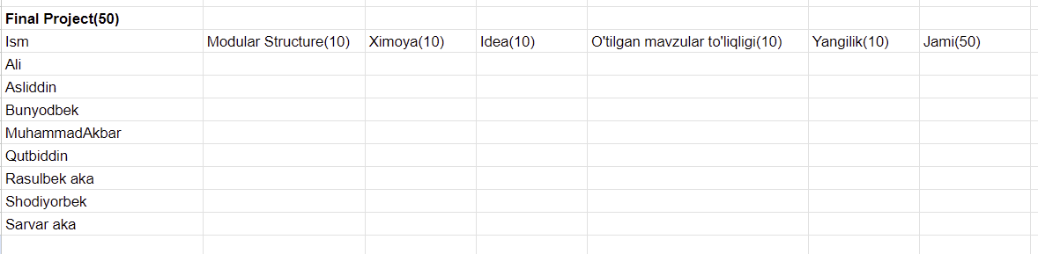

Project 4
Maximal darajada o’tilgan mavzularni qamrab oling
Payshanba soat 18:00(14:00) gacha topshiring

Slide 5
Takrorlash

Slide 6
Model Performance Improvement

Slide 7
Model Performance Improvement
Data-Based Approaches
Model-Based Approaches
Training-Optimization
Feature/Representation-Based Approaches
Evaluation & Monitoring

Slide 8

Model Performance Improvement:Data-Based Approaches
Data-Based Approaches
Data Cleaning
Handle missing values (SimpleImputer, forward/backward fill, or dropping rows/columns).
Remove duplicates or outliers.
Feature Engineering
Create meaningful features (ratios, differences, transformations like log or polynomial features).
Aggregate or encode features (e.g., target encoding, one-hot, ordinal encoding).
Data Augmentation
For images, text, or time series: flip, rotate, crop, or perturb the data.
For tabular: synthetic samples (SMOTE for imbalanced classes).
Resampling & Balancing
Oversampling minority class or undersampling majority class for classification.
Weighted loss functions if class imbalance exists.
Increasing Dataset Size
Collect more data, or use transfer learning/pretrained embeddings.

Slide 9
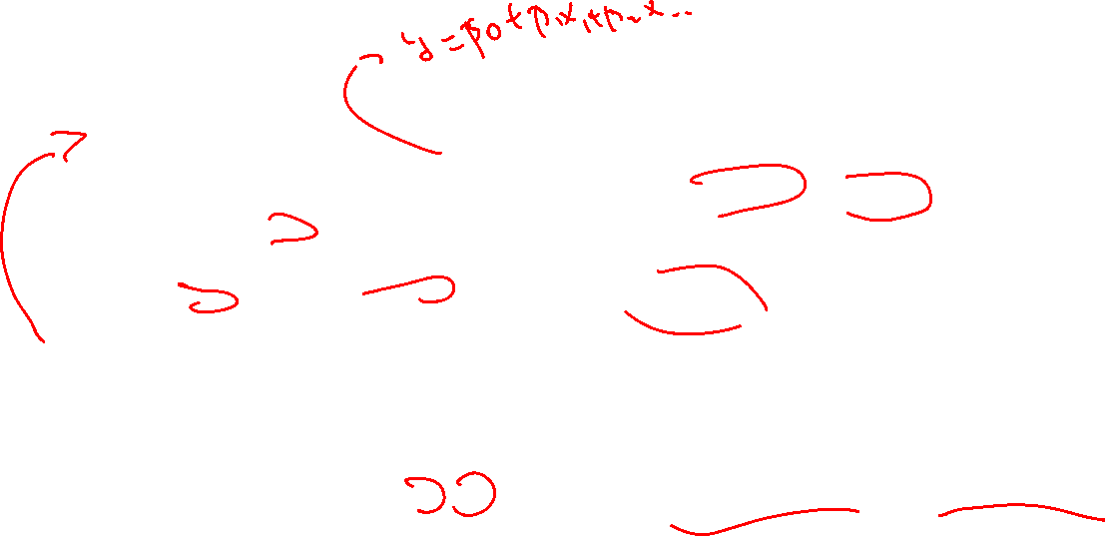
Model Performance Improvement:Model-Based Approaches
Model-Based Approaches
Algorithm Selection
Try different algorithms: Linear models, tree-based models, boosting, neural networks, SVM, etc.
Hyperparameter Tuning
Grid Search, Random Search, Bayesian Optimization.
Ensemble Methods
Bagging (Random Forest), Boosting (XGBoost, LightGBM, CatBoost), Stacking, or blending.
Regularization
Prevent overfitting using L1, L2 penalties, dropout (for neural nets), early stopping.

Slide 10

Model Performance Improvement:Training Optimization
Training & Optimization
Feature Scaling
StandardScaler, MinMaxScaler, RobustScaler for numerical features.
Cross-Validation
K-fold CV to avoid overfitting to one train-test split.
Learning Rate Optimization
Adjust learning rate schedules, adaptive optimizers (Adam, RMSProp).
Batching / Sampling
Use mini-batches for large datasets or class-stratified sampling.
Early Stopping
Stop training when validation performance stops improving.

Slide 11

Model Performance Improvement:Feature Represenation-Based Approaches
Feature Representation – Based Approaches
Feature Selection
Remove irrelevant/redundant features (correlation analysis, SHAP, permutation importance).
Dimensionality Reduction
PCA, t-SNE (for visualization), UMAP, or autoencoders.
Encoding & Transformation
Non-linear transformations, log, square root, or categorical encoding.

Slide 12

Model Performance Improvement: Evaluation & Monitoring
Evaluation & Monitoring
Error Analysis
Check which samples are mispredicted and why.
Metrics & Loss
Ensure the right metric for the problem (RMSE vs MAE vs R² for regression, precision/recall/F1 for classification).
Learning Curves
Identify underfitting vs overfitting.

Slide 13
Error analysis

Slide 14

Error analysis
ML Process
Qayerda model notogri predict qilgan samplelarni(datalarni) tekshirish jarayoni
Muammoni sababini topishga yordam beradi:
Ma’lumot sifati (yetishmayotgan qiymatlar, noto‘g‘ri belgilangan ma’lumotlar, outliers)
Feature yetishmovchiligi (muhim featurelar yetishmovchiligi)
Model (Over/underfitting)
Data taqsimoti (train/test bo‘linmalaridagi taqsimot o‘zgarishi)

Slide 15
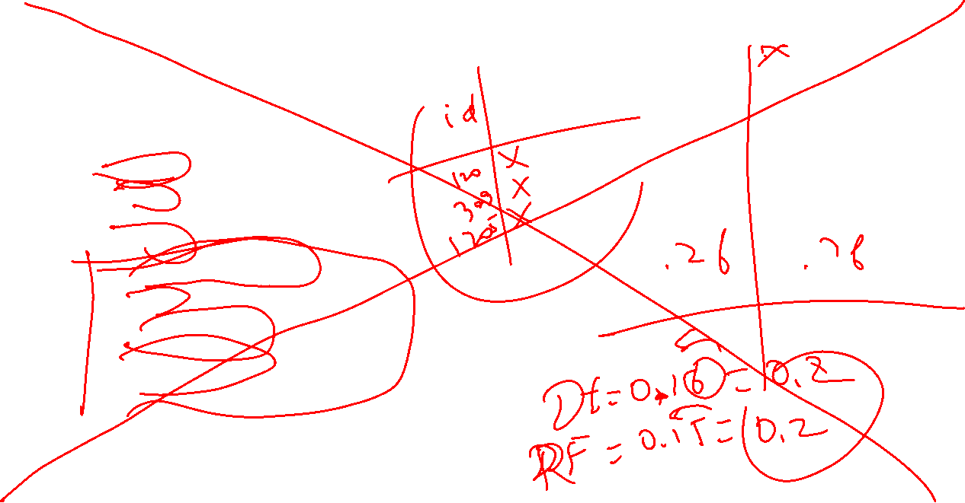
Error analysis
Ketma ketlik
Train
Predict
Metrics
Errorlarni xisoblash
Yomon predictionlarni aniqlash
Patterni aniqlash
Visualize errors

Slide 16

Error analysis
Error analysisdan keyin quyidigilardan biri/xammasi qilinishi kerak:
Data Issues: Fix missing, mislabeled, or noisy data.
Feature Engineering: Add features that explain hardest samples.
Algorithm Tuning: Consider more complex models if underfitting.
Ensemble Models: Combine models to reduce variance.
Segmented Modeling: Train separate models for different subgroups.

Slide 17
1-oy taxlili

Slide 18

1-oy taxlili(1)
Git bilan ishlash
Folder/file ochish
Projectga ulash
Standalone va ichki
Turli xil commandalar

Slide 19

1-oy taxlili(2)
Logging va error
Data Extraction, merging, concat
Virtual Environment
Classlar bn ishlash
Src+Notebook
Src+Scripts
Data Loading
Preprocessing
Model Training
Modelni rivojlantirish
Error analysis
Pipeline
Custom(Manual)
Auto
Jami 4 ta Modular Model

Slide 20
Vazifa

Slide 21

Vazifa
1-oy uchun report yozing(examga tayyorgarlik)
Project 4 ga error analysisni qo’llang

